Slide 1




Huddle Meet
SkillSync

Slide 2
Session Purpose
Align expectations for January
Clarify working model and discipline
Remove ambiguity around roles, communication, and ownership
Set a predictable execution framework
Notes:
“Let’s talk about how we work as a team.”
(pause) “First thing — don’t work on impulse. Don’t jump just because something feels urgent.”
(pause) “Second — clarity matters more than speed. Fast work with confusion creates rework. Slow and clear work saves time later.”
(pause) “Third — finish what you start. Starting five things and finishing none gives a false feeling of productivity.”
(pause) “And lastly — write things down. If it’s only in your head, it doesn’t exist for the team.”
“Simple rules. Follow these, and work becomes lighter.”

Slide 3
Team Working Principles
Process over impulse
Clarity over speed
Completion over multitasking
Documentation over memory
Notes:
“Let’s talk about how we work as a team.”
(pause) “First thing — don’t work on impulse. Don’t jump just because something feels urgent.”
(pause) “Second — clarity matters more than speed. Fast work with confusion creates rework. Slow and clear work saves time later.”
(pause) “Third — finish what you start. Starting five things and finishing none gives a false feeling of productivity.”
(pause) “And lastly — write things down. If it’s only in your head, it doesn’t exist for the team.”
“Simple rules. Follow these, and work becomes lighter.”

Slide 4
Primary Time Zone
Team operates in EST
IST overlap acknowledged
EST remains execution anchor
Notes:
Time zones are important for smooth coordination. I am and Abhinav are in IST, and Harman is in EST. To make sure everyone can join, team meetings will mostly be on Saturdays, and I will set the time so it works for all.
Please keep this in mind and plan accordingly.

Slide 5

Daily Work Structure
8 hours of planned work
Written daily agenda mandatory
Two 10-minute breaks
One 30–45 minute lunch
No unplanned calls
Notes:
(pause) “Let us talk about a normal workday. Nothing fancy. Just a proper, planned day.”
(pause) “The base expectation is simple. Plan eight hours of focused work every day.”
(pause) “Start your day with a small agenda — three to four clear points. That is enough. Take two short breaks and one proper lunch.”
(lower pitch) “This is not control. This is to avoid burnout and confusion. When days are unplanned, learning drops, confidence drops, and mistakes increase.”
(pause) If leave is planned in advance, apply early. If a batch is assigned and leave is taken during that period, a nudge will be recorded and HR will act as per company policy.”
(pause) “Keep Viber and email active during work hours on both laptop and phone. This helps us stay responsive and avoid delays.”
(pause) “Please review the updated Trainer Utilization Policy email. Maintaining 60% utilization is your responsibility. Inform me once you have reviewed it.”
(lower pitch, slower, clearly separated) “One important clarification before we close this topic.”
(pause) “The standard expectation remains eight hours. However, currently only two of you have an 8-hour or 10-hour work flag.”
(pause) “In the future, there may be situations where I ask if you can extend for a few days.”
(lower pitch) “This will never be mandatory.”
(pause) “If you prefer not to be asked, tell me clearly. I will respect that completely. This flag only helps me understand flexibility for planning and future opportunities.”
(pause, close calmly) “Stay planned. Stay accountable. Respect time.”

Slide 6
Workday Discipline & Learning Responsibility
Planned days reduce burnout and confusion
Unplanned work impacts learning and confidence
Presence and ownership expected during work hours
Notes:
“During these working hours, be fully present and responsible. Attend all HR-organised sessions. If you are not in a batch and a session appears on your calendar, you must attend. I may sometimes miss posting in the group, so checking your calendar is your responsibility.”
(pause)

Slide 7
HR Sessions & Organisational Commitments
Attend all HR-organised sessions
Mandatory attendance if not in a batch
Calendar ownership lies with the individual
Active participation is expected

Slide 8
Delivery Readiness & TBT Rules
Do not accept TBT without strong course command
Ability to handle questions is mandatory
Consult manager before proceeding
Notes:
“Do not accept TBT until you have strong command over the course. Delivery requires confidence and the ability to handle questions. If you feel ready to deliver, consult me first before proceeding.”
(pause) “Be disciplined with official communication. Respond to emails on time. Submit your DSR and BRR without delays. Repeated delays will result in a nudge from my side.”
(pause) “Send your DSR every day before 6:30 PM. If you are in a batch, DSR is not required for that day. If you have a batch scheduled for next week, share your BRR by Thursday before 1 PM so readiness can be checked in advance.”
(pause)

Slide 9
Meeting Discipline & Course Ownership
Use shared background in all official meetings
01
Join on time; timings are mandatory
02
New course assignments require exam clearance before conclusion
03
Notes:
“Use the shared background in all official meetings. Join on time. Timings are mandatory.”
(lower pitch) “If a new course is assigned, you are expected to prepare properly and clear the exam on or before the course conclusion date.”
(pause) “All leave requests must be submitted through RMS only.

Slide 10

Leave Planning & Availability
All leave requests must be submitted through RMS only
Advance leave planning is mandatory
Leave during assigned batch leads to nudge and HR action

Slide 11

Responsiveness & Availability
Keep Viber and email active during work hours
Laptop and phone availability required
Responsiveness avoids delays and escalation

Slide 12

Utilization & Work-Hour Flexibility
Base expectation remains 8 hours of work
60% utilization responsibility applies to all
Trainer Utilization Policy must be reviewed
Extended hours may be requested temporarily
Extension is never mandatory; opt-out is respected

Slide 13
Official Communication & Reporting
Official Communication & Reporting
Timely response to official emails
DSR submission mandatory (non-batch days)
BRR submission mandatory before scheduled batches
Delays will result in a nudge

Slide 14
Availability Rules
Manager not always available due to time difference
Doubts must be noted and scheduled
Ping only if mission-critical
Notes:
“Now availability.”
(pause) “I need you to understand one thing clearly. Because of the time difference, I may not always respond immediately.”
(pause) “That does not mean I am not supportive.”
(pause) “Write your doubts. Collect them. We will discuss them properly.”
(lower pitch) “Calling randomly should be only when something is genuinely critical.”
(pause) “This keeps discussions meaningful instead of rushed.”

Slide 15
Communication and Escalation Rules
Single DSR email thread
DSR reflects actual work and challenges
No side conversations or politics
Manager looped on HR emails
Notes:
“One DSR thread. One place.”
(pause) “Write what you did. Write what you couldn’t do. Write where you are stuck.”
(pause) “No side stories. No parallel chats. No politics.”
(lower pitch) “If communication is scattered, responsibility becomes unclear.”
(pause) “Loop me on HR mails. That’s mandatory.”

Slide 16
Communication Alignment
Focus on work not tone
Direct language is not personal
Professional maturity expected
Notes:
“I want to say this clearly.”
(pause) “My communication can be direct.”
(pause) “That does not mean disrespect. It means I don’t want confusion.”
(lower pitch) “Focus on the message, not how sweet or hard it sounds.”
(pause) “If something is wrong, it needs to be said clearly so it can be fixed.”

Slide 17
Use of AI and Tools
AI to be used actively and responsibly
AI improves productivity and clarity
AI is not a shortcut
Ownership remains with individual
Notes:
“Now AI.”
(pause) “AI is not optional anymore.”
(pause) “Use it to understand topics, prepare content, structure thoughts, save time.”
(pause) “But don’t blindly copy. You still need to understand.”
(lower pitch) “If you don’t use available tools, you will always feel overloaded.”
(pause) “AI helps you work smarter, not escape work.”

Slide 18
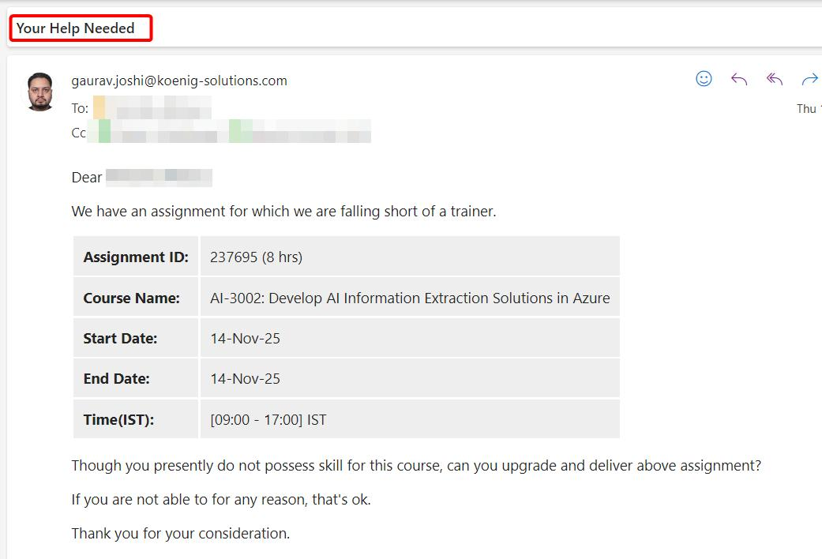
Help Needed Emails
Notes:
(pause) “Whenever you receive emails like this — asking if you can support or deliver a particular course — the first thing you should check is your availability on the mentioned dates.”
(pause) “If you are available and you genuinely feel confident that you can deliver the assignment, then you may go ahead and mark your skill for the course.”
(lower pitch) “But do this only after reviewing the Table of Contents.”
(pause) “If you already know the content well, then there is no issue — you’re good to proceed.”
(pause) “If the content is new, or only partially familiar, stop and assess how quickly you can realistically upgrade your knowledge before the delivery.”
(lower pitch) “Be honest with yourself here. We are not doing this just to increase utilization numbers. Our responsibility is to deliver with confidence and quality.”
(pause) “Also remember, batches can be of any mode — corporate, international, fast-paced — and expectations are always high.”
(pause) “So do not rush to accept assignments just because they are available.”
(pause, close calmly) “Only take ownership when you are truly ready to own the delivery end-to-end.”

Slide 19
ABHINAV – INDIVIDUAL DISCUSSION

Slide 20
Behavioral Focus
Avoid interrupting in meetings
Follow listen then summarize then respond
Notes:
“I’ll be very straightforward here.”
(pause) “You know your stuff. That is not the issue.”
(pause) “The issue is cutting people off in meetings.”
(pause) “When someone is explaining and gets interrupted, the flow breaks.”
(lower pitch) “From now on — listen fully, summarize in one line, then respond.”
(pause) “This one change will improve your impact immediately.”

Slide 21
Reason for Discussion
Knowledge not the issue
Meeting presence impacts team confidence
Senior behavior sets team tone
Notes:
“This is being discussed because you are not a junior anymore.”
(pause) “People observe seniors and copy behavior.”
(pause) “If you stay calm and structured, the team stays calm.”
(lower pitch) “That’s why this matters.”

Slide 22
Role Expectations
Act as stability anchor
Mentor Harman when not in batch
Deliver detailed mock reviews
Maintain meeting etiquette
Notes:
“You are expected to be a stable point.”
(pause) “When Harmandeep or others need guidance, you help.”
(pause) “When mocks happen, feedback should be clear and written.”
(lower pitch) “Consistency matters more than brilliance here.”

Slide 23
HARMAN – INDIVIDUAL DISCUSSION
Notes:
“Harmandeep, now coming to you.”

Slide 24
Observed Challenges
Starts next point before finishing current one
Task hopping due to urgency mindset
Notes:
“You have good energy. That’s clear.”
(pause) “But one issue is — before finishing one thing, you start another.”
(pause) “This creates half-done work.”
(lower pitch) “Half-done work gives stress and confusion later.”

Slide 25

Corrective Framework
Maximum two active tasks
Avoid parallel topic switching
Focus on closure
Notes:
“So the rule is simple.”
(pause) “Maximum two active tasks at a time.”
(pause) “Finish one properly, then move to the next.”
(lower pitch) “This is not slowing you down. This actually makes learning stable.”

Slide 26

Definition of Done
Notes completed
Labs completed
Qubits completed
Questions completed
DSR reflection completed
Notes:
“A topic is done only when everything is done.”
(pause) “Notes. Labs. Qubits. Questions. DSR reflection.”
(lower pitch) “If any one is missing, the topic is not done.”
(pause) “This removes confusion during exams and delivery.”

Slide 27

Behavioral Guidance
Finish properly before moving ahead
Patience builds long-term speed
Transparency encouraged
Notes:
“Patience is important here.”
(pause) “Finishing properly today saves panic tomorrow.”
(pause) “If something is unclear, say it early.”
(lower pitch) “Direct communication is always better than silent stress.”

Slide 28
COMMON DISCUSSION
Notes:
“Coming back to common points.”

Slide 29
Batch Readiness Rules
100 percent course preparation required
Certification exam mandatory
Retake plan logged if needed
No go-live without readiness
Notes:
“No batch goes live unless preparation is complete.”
(pause) “Course done. Practice done. Certification aligned.”
(lower pitch) “These rules protect you as much as they protect delivery quality.”

Slide 30
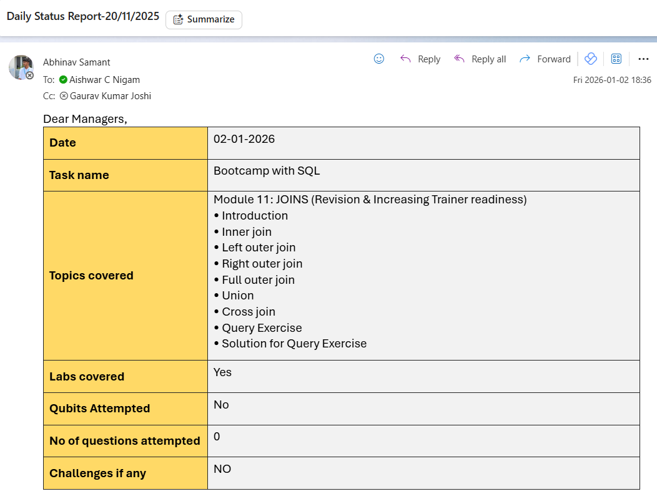
DSR
Notes:
(pause) “Now let’s talk about DSR, and I want everyone to look at this example carefully.”
(pause) “This is the exact format you must follow. Nothing extra. Nothing missing.”
(pause) “You start with the date. Then clearly mention the task name, like Bootcamp with SQL.”
(pause) “Under Topics covered, mention the module name first, and then list the subtopics clearly — introduction, joins, exercises, solutions — exactly like this.”
(lower pitch) “This helps us understand what you actually worked on, not just that you were busy.”
(pause) “Then clearly mention whether labs were covered — yes or no. Same for Qubits attempted.”
(pause) “Mention the number of questions attempted. If it is zero, write zero. Do not leave it blank.”
(pause) “Under Challenges, write No if there are none. If there is a challenge, mention it briefly and clearly.”
(pause, firm) “Now the most important rule.”
(pause) “There must be one single email thread only, with the subject line exactly like this: Re: Daily Status Report-dd/mm/yyyy”
(lower pitch) “In that email trail, there should be only the DSR. Nothing else.”
(pause) “Either I or Gaurav Sir may ask questions related to the DSR in the same email thread, so keep it clean and consistent.”
(pause, close clearly) “Follow the format exactly. Every day. No deviation.”

Slide 31
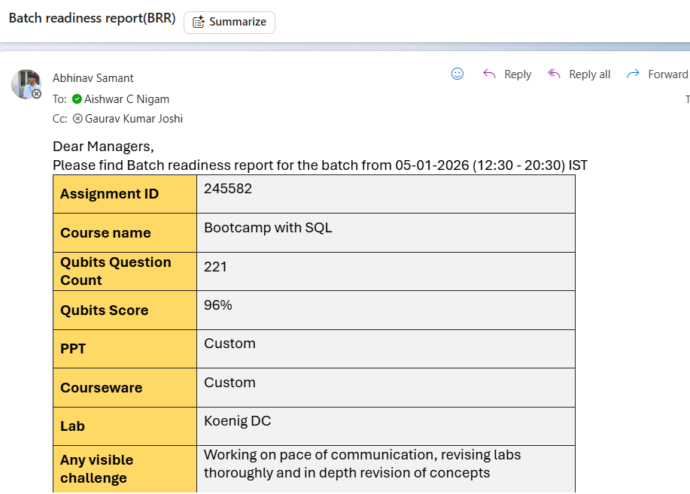
BRR
Notes:
“Now let’s talk about BRR — Batch Readiness Report.”
(pause) “This report must be sent by Thursday before 1 PM. The timing is important.”
(pause) “The purpose of BRR is very simple — to understand how ready you are for the upcoming batch, before the batch actually starts.”
(pause) “Look at this example carefully.”
(pause) “You must clearly mention the assignment ID and course name.”
(pause) “Then mention your Qubits question count and Qubits score. This gives us a quick view of concept coverage and confidence.”
(lower pitch) “Mention whether your PPT and courseware are standard or custom, and clearly state the lab setup you are using.”
(pause) “Most importantly, the visible challenge section.”
(pause) “This is where you honestly mention gaps — maybe pace of communication, lab confidence, or concept depth.”
(lower pitch) “This is not a weakness. This is what helps us step in early and support you.”
(pause) “If BRR comes late, or is incomplete, we lose the window to help.”
(pause, firm close) “So remember — BRR by Thursday, before 1 PM, in the same clean format, pasted in the email body. This helps us fix readiness issues before they become batch problems.”

Slide 32
Culture and Boundaries
No internal politics
No external influence
HR reassignment possible if misaligned
Rules apply while reporting continues
Notes:
“No politics. No back-channel influence.”
(pause) “If something is wrong, talk directly.”
(lower pitch) “As long as we work together, rules apply.”

Slide 33
Key Takeaways
EST is anchor time zone
Planning over reaction
AI is mandatory skill
Discipline non-negotiable
Transparency mandatory
Notes:
“To summarize in simple words…”
(pause) “Work with structure. Communicate clearly. Use tools. Finish what you start. Ask for help early.”
(lower pitch) “If you do this, work becomes manageable, not stressful.”

Slide 34

Action Items
Continue single DSR thread
1
Follow daily agenda discipline
2
Apply feedback immediately
3
Raise challenges early
4
Execute January plan without deviation
5
Notes:
“We end with action.”
(pause) “Single DSR thread. Daily planning. Apply feedback immediately. Raise issues early.”
(lower pitch) “January should be clean. That’s the goal.”
(pause) “Alright. Any doubts before we close?”

